Slide 1

Practising data science in the real world
Limitations and challenges
Dimitri Scronias, ORS PACA/AP-HM

Slide 2
What is this class about?
Make you think critically about data and statistical methods
Basics you should be able to do/think about as a statistician, data scientist, etc.
Issues and difficulties surrounding data you will encounter in your work
Mainly targeted to people working directly on raw data…
However, you can still benefit from it even if you won’t: everybody works using data at some point
Practical exercises using (mainly) dirty data
Notes:
Practical exercises using (mainly) dirty data: tell them that’s a problem and that working on toys dataset doesn’t prepare you to all the data manipulation you’ll have to do

Slide 3
How I made this class
Multiple books, which I reference throughout the course (have a look at them!)
My personal experience, stuff I wish I knew when I started working
Issues/problems I think you should be aware about as a DS/stat
Though nobody will expect you to be experts on these subjects!
What I would like you to know if I were to interview you for a stat/DS position
Also, my goal is mainly to make you employable as a stat/DS, and give you a rundown of common challenges, possible solutions and good resources in a condensed format

Slide 4



Who am I?
2021–24 Assistance Publique – Hôpitaux de Marseille, ORS PACA
Soladis Group, ATIH
2019–21 Assistance Publique – Hôpitaux de Paris, ORS PACA
2021 DESU Data Science, AMSE
2019 M2 Economics – Economic Policies Analysis, AMSE

Slide 5

Stuff I have worked on
Vaccination
Opinions and practices of healthcare workers (general practitioners, nurses, specialists) w.r.t. vaccination
GPs’ recommendations practices of COVID-19 vaccines
Vaccine coverage and delays among French children
Emergency services’ quality of care, pressure, classification of diseases
Neurodegenerative diseases
Costs measurements of Parkinson disease from RWD
Notes:
And probably other things that I have forgotten about

Slide 6
Summary
“So, can you tell me about the different steps in a data project?”
—Some recruiter (whose name I forgot)
Notes:
ASK STUDENTS WHAT THEY THINK

Slide 7
Summary
Defining needs
Data manipulation & cleaning Missing data & imputation, data quality and reliability…
Modelling Bias and fairness, interpretability and explainability, scalability and performance
Communicating results Communication and collaboration
Plus: programming exercises in-between

Slide 8
Additional info on the course
Centered on:
Tabular data
My experience in public health
We’ll alternate between classes and labs where you’ll have to work on data
I will send the slides, they will be available on my GitHub
https://github.com/Dscronias
If you’ve seen the syllabus: no parts about data privacy, regulatory and legal constraints, etc…
You’ll have the programming exercises instead (:

Slide 9
Final assignment
Find a messy dataset with at least 10 variables (features), and >1K observations (instances)
Have a quick look at the data
Find some business question (or something interesting) and do a data analysis plan
Clean the data: check for missing data, aberrant values, think about potential biases (may be hard)
Do analyses to answer your question (univariate, bivariate, multivariate if needed)
Interpret your results
Do some data viz

Slide 10
Websites to find data
Scraped Airbnb data: https://insideairbnb.com/
UC Irvine ML repo: https://archive.ics.uci.edu/datasets?NumInstances=1000-inf&skip=0&take=10&sort=desc&orderBy=NumHits&search=
AskAManager Salary Survey: https://docs.google.com/spreadsheets/d/1PXn7AoKOmZ-Za4Bz_-4tfoNfiddrLRQGWunM8F53Th8/edit?resourcekey=&gid=1245463581#gid=1245463581
Financial well-being survey data (great source): https://www.consumerfinance.gov/data-research/financial-well-being-survey-data/ (don’t forget to download the file codebook, on top of the data)

Slide 11

Questions?
dimitri.scronias@inserm.fr
It’s not the end of the class.

Slide 12
I. Defining needs

Slide 13
What we’ll see
Defining data and data science: what it is, what it is not
Planning your analyses:
Doing a data analysis plan
Data types
Modelling strategies
Pre-hoc variable selection
Tools and software

Slide 14
Resources
Simon Thompson. 2023. Managing Machine Learning Projects: From design to deployment
Provost F., Fawcett T. 2013. Data Science for Business: What you need to know about data mining and data-analytic thinking (2013)
Ameisen, Emmanuel. 2020. Building Machine Learning Powered Applications: Going from Idea to Product

Slide 15

Last advices before starting
For jobs in France, try the APEC: I was called 3-4 times a week for DS/biostatistics positions by recruiters when I posted my CV there
Check the average salary for your job on Glassdoor or the APEC, bump that by 10% when negotiating
If you want to train for interviews, go to job fairs and talk to literally everyone
Remember you are trying to sell a product: yourself, a capable working professional
If your goal is to increase your salary quickly, don’t stay in the same company
Have fun working until retirement!
Notes:
Check the average salary for your job on Glassdoor or the APEC, bump that by 10% when negotiating: worst thing they will say is no

Slide 16
🌈Data science🌈 What? Why?
DS involves “principles, processes and techniques for understanding phenomena via the analysis of data” (Provost F., Fawcett T.)
Main goal: help decision-making (Data-Driven Decision Making)
Avoid uninformed decisions like “we have always done it this way”, counterproductive “intuitive decisions”, or sometimes plain stupidity or dangerous decisions.
Notes:
Ask students what data science is

Slide 17
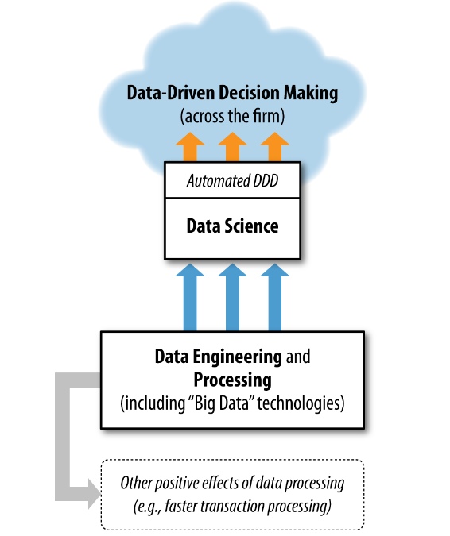

🌈Data science🌈 What? Why?
Very simplified model of the goal of DS in a firm
DDD associated with increase in productivity in a firm
Keep in mind sometimes DS is not used for decision making! (but that is what we will focus on)
Provost F., Fawcett T. Data Science for Business.

Slide 18
Key takeaway (for the whole course)
Your job is to make data interpretable for decision-makers to make informed, data-driven decision.
Remember you will be dealing with people that:
Do not understand statistics as well as you;
May be focused on getting results.
Key skill: learning how to simplify complicated findings from data
Notes:
Does not understand statistics as well as you: that will be something new for you when you get into your new job. You now might be one of the most knowledgeable person about stats/economics/other where you work at (except for seniors).
So, in a nutshell : keep the smart stats stuff is for other statisticians/data scientists/math nerds
Doing data science is useless if you can’t communicate your findings clearly

Slide 19
But what is data?
“Factual information (such as measurements or statistics) used as a basis for reasoning, discussion, or calculation”
— Merriam-Webster
“The word ‘data’ is commonly used to refer to records or recordings encoded for use in computer, but is more widely used to refer to statistical observations and other recording or collections of evidence”
— Zins C. (2007). Conceptual approaches for defining data, information and knowledge.
The article above contains more than 40 definitions for data.
Notes:
WHAT DO YOU THINK DATA IS?

Slide 20
Deconstructing data
Data comes from Latin “dare”, “to give”.
“Data are (or datum is) an abstraction. I mean, the concept of ‘data’ or ‘datum’ suggests that there is something there that is purely given and that can be known as such. The last one hundred years of (late) philosophic discussion and, of course, many hundred years before, have shown that there is nothing like ‘the given’ or ‘naked facts’ but that every (human) experience/knowledge is biased.”
— Zins C. (2007). Conceptual approaches for defining data, information and knowledge.

Slide 21
Data as obtained, not given
Good data is difficult to obtain:
Questionnaires, often costly and difficult to administer
(Underpaid) workers that label millions of images for generative AI
Human input in software (e.g. emergency services, hospitals…)
Complicated pipelines of automated systems (e.g. French National Health Insurance)
These are the first layers of human biases, subjectivity or potential errors than can bias your data
Notes:
Questionnaire: also, need to be sure the questions are well understood, that respondents are not faking everything, plus depending on how you administer questionnaires (online, phone…) you have different problems like costs, bots responding…
One time, in a project, we had to scrap half of the responses to an online questionnaire, because we eventually realised that their respond times were unrealistic, and it fact we found out the respondents were robots
When AI Eats Itself: On the Caveats of Data Pollution in the Era of Generative AI
https://arxiv.org/abs/2405.09597

Slide 22

Data as capta (1)
Johanna Drucker (researcher in digital humanities) talks of capta: “Data are capta, taken not given, constructed as an interpretation of the phenomenal world, not inherent in it.”
Also: “Data are never neutral, but always constructed from some point of view, with a specific set of values and beliefs.”
Check out The Digital Humanities Coursebook, which offer a fresh perspective and counterpoint to typical data science courses
J. Drucker also does nice art, but this is irrelevant to the course

Slide 23
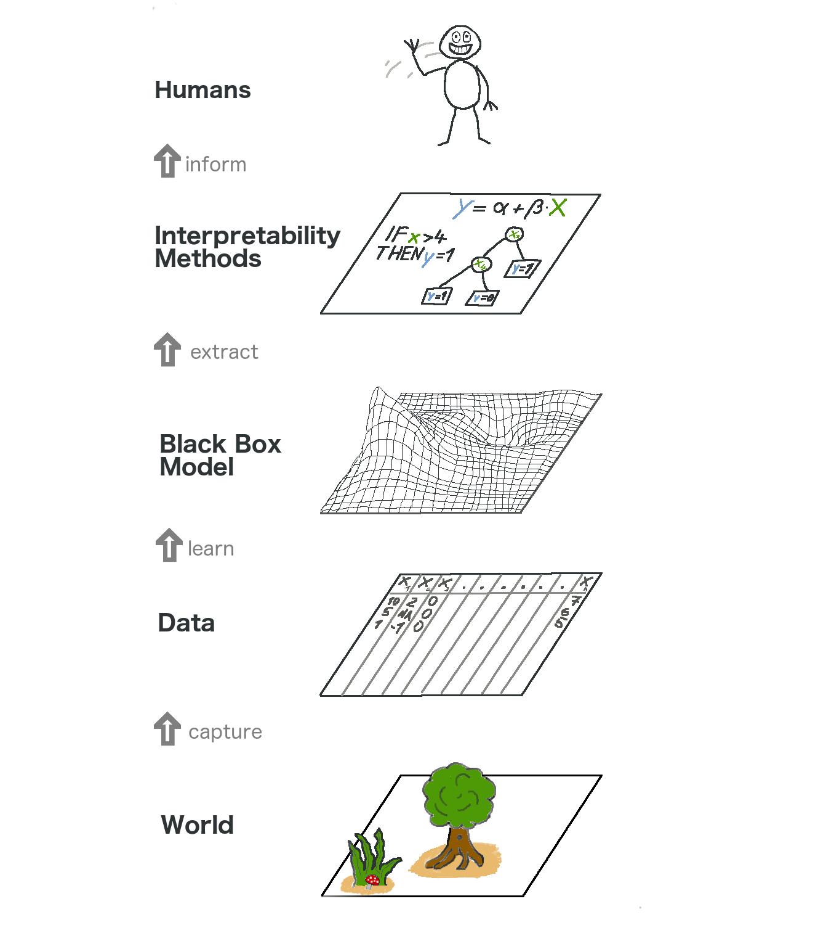
Data as capta (2)
You have human interpretation at each step of the life cycle of data:
At the ground level, when and where data is collected
➔ You need to be aware of potential issues that arise there
When you analyse, modify, mine the data
➔ That is literally your job
When results are interpreted by others
➔ You must work on your communication skills to be sure people really understand your results

Slide 24
Data as capta (3)
Critically thinking about data quality, reliability, and bias is a core skill you need to develop
Notes:
This is a concept that is often talked about in humanities/social sciences (so, sociology, anthropology), which are very critical of how “data” is considered in hard sciences: something that is factual, true, objective.
That’s also, imo, what will distinguish you from people in computer science who do AI, in that you first started with economics, and you are used to critically thinking about models.

Slide 25


Back to business
As a data worker, your projects always start with a query, by a client, product owner, boss...
First task you will do on any new project: planning.
Boss
Tip
As soon as you get your first job, keep in mind you are the specialist who knows how to make data talk (and no longer a student). This is also applicable to your interviews.

Slide 26
Planning analyses (1)
Good practice: prepare a data analysis plan (a roadmap)
What to plan: data collection, variable selection and modifications, imputation, weighting, which models, etc. etc.
Choosing the right tools (e.g. programming language) is also more important than you think
Did you know?
Sometimes (in clinical research for example), all analyses must be planned.
If you decide to change even one thing, you must discard the data and start everything from scratch.
Notes:
Note: I won’t give a specific layout for this, you do whatever you want. It’s just suggestions, and what I do personally

Slide 27
Planning analyses (2)
In some jobs, a data analysis plan may be a requirement (in this case, you have a predetermined layout to follow)
If not, you should put:
Data collection methodology
Quick description of the metadata: variables, their types, how many observations, are there clusters, is it a sample or administrative data…
The question you are trying to answer
Software/languages you are going to use
Variables selected for analyses
What analyses will be made
How results will be interpreted (coefficients? Metrics? Graphs? Something else?)
Ideally, do this before taking deep looks at the data (otherwise, you might be biased by the results you have already found)
Notes:
If it’s not a requirement, keep it simple

Slide 28
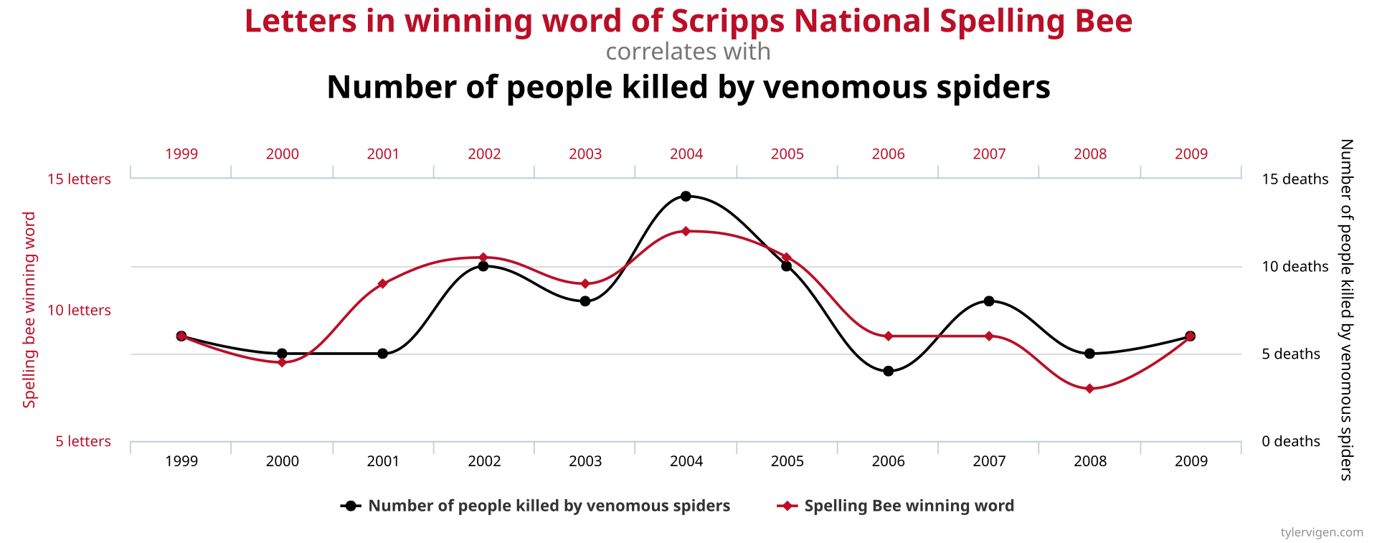
Planning analyses (3)
In practice, you may somewhat deviate from your analysis plan and add to it (post hoc)
See it as a baseline for your work…
…but don’t push it just to get significant results (“p-hacking”)
“If you torture the data long enough, it will confess to anything” (Coase R.)
After you have started working on your data, keep your final methodology and results somewhere:
Cleaning and modifications in the data that you have made
Analyses you have done
Graphs, tables, etc.
Notes:
P-hacking can be:
Taking subsets of the data to get significant results
Only showing significant results
Include covariates to get significant results
Transforming the data to get significant results

Slide 29
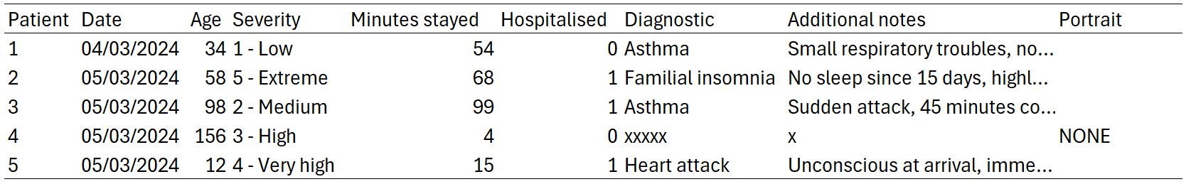




Common variable/data types
Notes:
Ask students what data type there is on the table

Slide 30



Quantitative variables
Discrete or continuous numerical variables
Numerical data in R can be stored as:
Integers, if there are no decimals
Floats, called “numeric” or “double” in R (for double-precision floating-point, meaning a number is accurate up to the 15th decimal)
This difference exists because integers have lower memory consumption

Slide 31

Dates
Well, it’s a date.
Watch out for time zones
Use the lubridate package to manipulate dates (not base R)
Common error
Check that your date variable is in “Date” or “POSIT” format, not “character”. This will cause errors.

Slide 32



Qualitative variables
Ordered variables, like severity: 1 > 2 > 3 > 4 > 5
Unordered (or nominal) variables, like Diagnostic (or Hospitalised)
Hospitalised is a special case called a binary variable, because it takes only two values
Qualitative variables can be stored as:
Strings, a sequence of characters (character type in R)
Factors, in R (a type made for categorical data, that can be ordered, and is more memory efficient than strings)

Slide 33

Text
You can do a lot of things with texts (which we won’t cover here)
You can create new nominal variables by hand from the texts content, for example
Or you can do more sophisticated work using Natural Language Processing (NLP)
These are always stored as strings/characters types

Slide 34

Images
You can also do a lot of things with images (which we won’t cover here)
This is a very specialized field, it is unlikely you will work on images
R is not the best choice for working with images, opt for Python instead (also this requires beefy workstations)

Slide 35
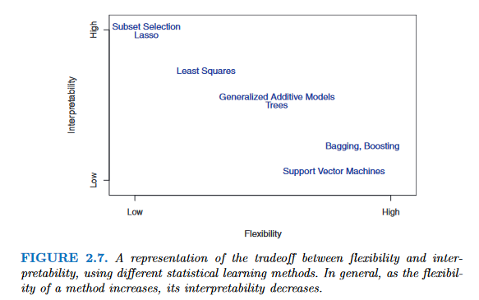
What models?
Interpretability vs. flexibility tradeoff
Decision makers want to know why you are getting the results you have
More flexible models, though more accurate, may be less valued because they are hard to understand
Sometimes, people just want coefficients from a regression model, or a single decision tree
From James GM. 2013. Introduction to statistical learning.
Notes:
Interpretability vs. flexibility tradeoff: do you know what it is

Slide 36
What models, but for my data? (1)
Always check the literature first, there may be specific estimation procedures to follow
In your research question, do you know what you have to estimate?
Yes, I have a dependent variable which I must predict/for which I must find associated factors ➔ Supervised methods (regressions, trees, kNN, etc.)

Slide 37
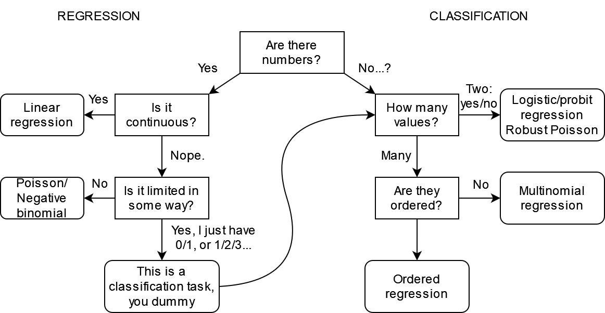
Supervised learning
Non-exhaustive list of commonly used linear models, and when to use them
Dep. variable
(i.e. is the data numerical?)
Note: you may use some ML models for both regression and classification, and may be robust to some specifications of the dependent variable

Slide 38
Some weird cases (1)
Watch out for limited dependent variables:
Variables with limited range of values (e.g. scales from 1 to 5)
In this case, don’t use a linear regression model
Test ordered logit/probit models
Or multinomial logit/probit if ordered logit assumptions are violated
Censoring and truncation
Censoring: you observe some floor or ceiling values in your dependent variables (e.g. annual income variable coded as >100,000€ when the true annual income is over this threshold).
Truncation: same as censoring, but the entire observation is missing from the data when the threshold is hit
Notes:
Note: here censoring is in the dependent variable. Censoring exists in survival analysis, but it refers to the observation window of participants in the study

Slide 39

Some weird cases (2)
You will encounter situations where you could have multiple candidate models
Example: length of stay in an emergency unit
You could model that with a (robust) linear regression…
But it’s strictly positive and discrete, so you could use a poisson/negative binomial regression
Zero-inflated, if you have a lot of zeroes…
Or throw everything out the window: it’s time-to-event data, so use survival analyses methods (Accelerated Failure Time, Cox…)
POV: Reviewer 2 trashing your choice of model and suggesting you should reconsider your whole career

Slide 40
What models, but for my data? (2)
Always check the literature first, there may be specific estimation procedures to follow
Do you know what you have to estimate?
Yes, I have a dependent variable which I must predict/for which I must find associated factors ➔ Supervised methods (regressions, trees, knn, etc.)
No? ➔ Unsupervised methods (clustering)

Slide 41
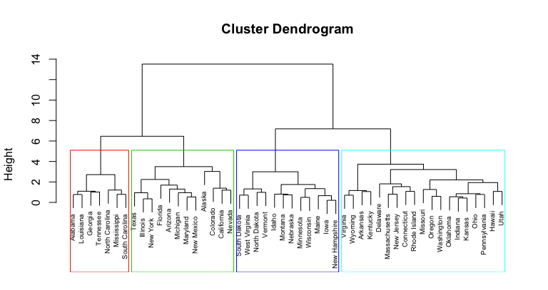
Unsupervised learning (1)
You don’t have a dependent variable, but you want to find groups in your data
Use clustering methods:
Hierarchical clustering (in my experience, this has always yielded good results)
K-means
OPTICS, DBSCAN…
These projects are a lot more exploratory:
You may propose multiple clustering methods
There are criteria to find an optimal number of clusters…
But don’t forget that the “best” clustering is the one that makes sense

Slide 42
Unsupervised learning (2)
Always check the characteristics of your clusters:
Cross-tabulate your groups with the variables you used as inputs in the algorithm
Or cross-tabulate with other variables that were not included as inputs
Good resources
https://scikit-learn.org/stable/unsupervised_learning.html
Cluster Analysis, 5th edition. https://cicerocq.wordpress.com/wp-content/uploads/2019/05/cluster-analysis_5ed_everitt.pdf
FactoMineR package. http://factominer.free.fr/index.html

Slide 43
What models, but for my data? (3)
Always check the literature first, there may be specific estimation procedures to follow
Do you know what you have to estimate?
Yes, I have a dependent variable which I must predict/for which I must find associated factors ➔ Supervised methods (regressions, trees, knn, etc.)
No? ➔ Unsupervised methods (clustering)
There are other paradigms:
Reinforcement learning
Semi-supervised
And others…

Slide 44
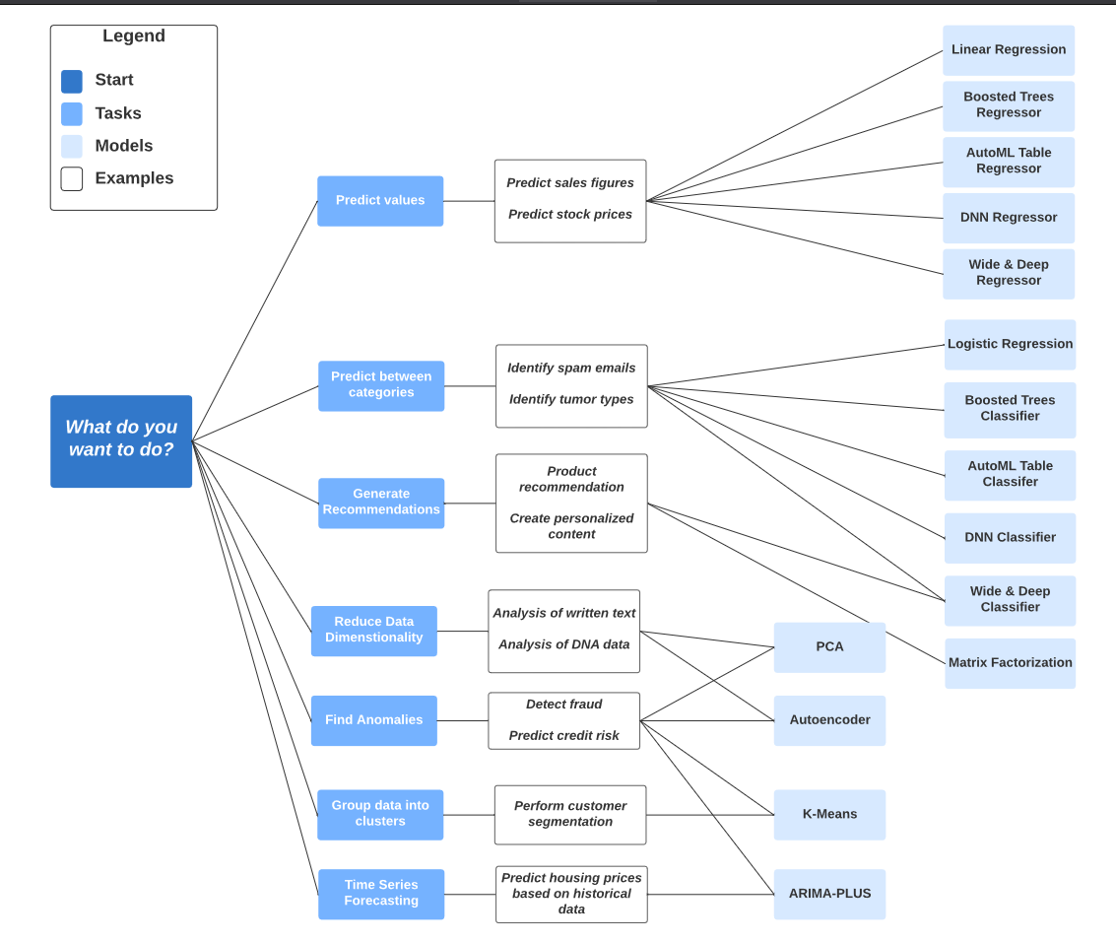
Google Big Query models cheat sheet
Non-exhaustive too, but it’s a useful cheat sheet depending on what you want to do

Slide 45

What variables to include?
Make ex-ante hypotheses, ideally based on:
Existing literature
Your own theoretical framework
You may add variables ex-post in your analyses (if your project allows it)
But don’t mine for statistically significant associations (aka “p-hacking”), significant risk of false positives
Watch out for data leakage in variables (mostly in prediction):
Information in historical data that should not be available when the model is run
Different from data leakage in observations: information from test data inside the training data

Slide 46
What potential biases?
We will see that later in the course, but at that point you should ask yourself if they may be biases in your data or in your future analyses:
Endogeneity (simultaneity, omitted variables…)
Sample selection
Attrition
Psychological biases in surveys (desirability…)
Biases are hard to find, especially without seeing the data. You may find problems with your data as you go along in your project.

Slide 47
What to report?
Very important:
You don’t do analyses in a vacuum, you are doing all this work to show results
Find out what the client wants:
Interpretable results? ➔ Use less flexible, more interpretable models
Just good, accurate results? ➔ Use big black box models!
Charts? An interactive dashboard?
Keep in mind these things take time, try to estimate how much time each thing will take (it’s hard even for seniors!)

Slide 48

How much resources?
Panicked data scientist who found out the hard way their data is too big
You may encounter hardware limitations
Hard to predict at beginner level
Some data wrangling on medium sized data may be too much for your computer to handle
Or a model (e.g. Random Forest) requires too much resources
How to solve?
Ask for a beefier computer (easiest solution, but costly)
Choose the right language & packages, write better code (cf chapter III)
Cloud computing (for Big Data)

Slide 49
What programming language? (1)
As a beginner, if you have the choice, use the one you are the most comfortable with…
But you won’t always have the luxury of choosing:
Some models may not be implemented (or implementable) in the language of your choosing
The language may not be suited for what you want to do
You may be working on virtual environments that only have specific programming languages

Slide 50
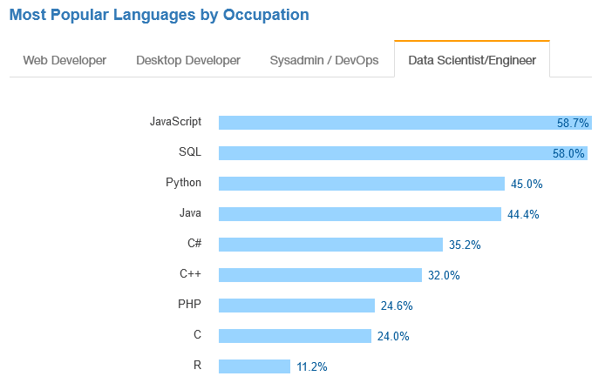





Popular languages
No real studies (afaik) on the most used languages among data scientists
Usually R/Python, with other languages being more situational
🤔
🤔🤔🤔
Stackoverflow Developer Survey 2017

Slide 51
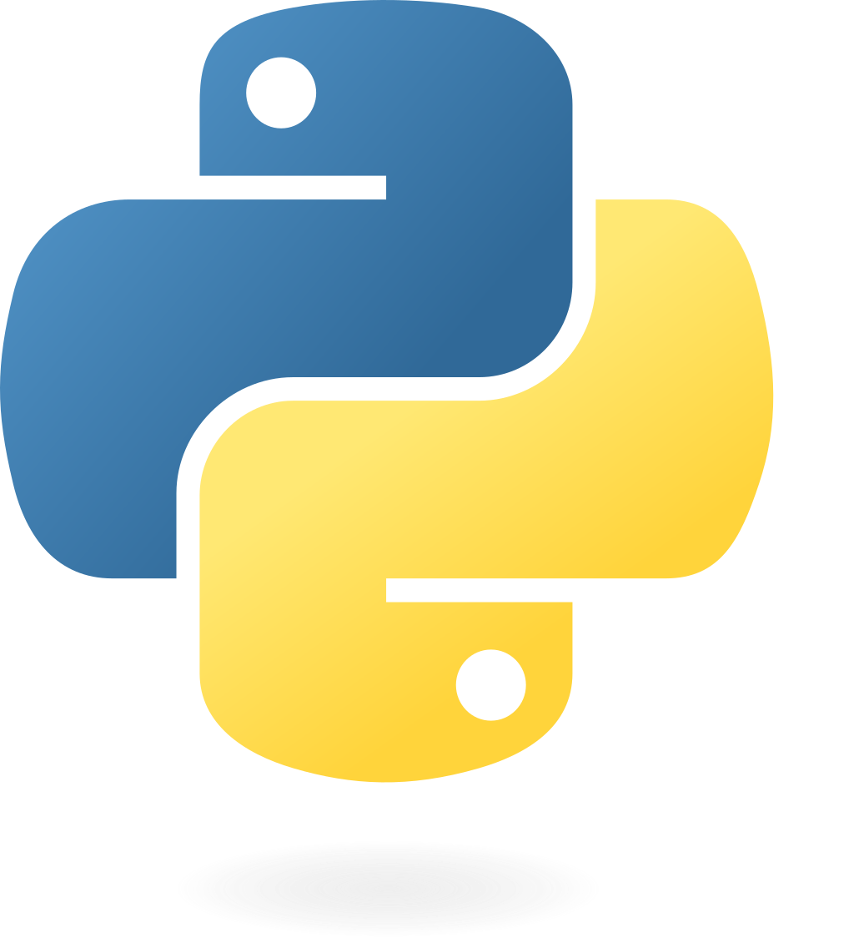

Popular languages: the big ones
Python: good to learn, mostly used for Machine Learning
Quite limited for stats compared to R (e.g. survey weighting, time series…)
Outside of stats/ML, used in software engineering
R: great for stats, still OK for ML
Use Python if you want to do Deep Learning or work on textual data
Some data scientists use both
You could use one as your ‘main’ language, and the other one for specific use cases
SQL: great if you work on big databases
If you use R, you can get away without knowing too much with dbplyr (automatically translates dplyr pipelines to SQL queries)

Slide 52

Popular languages: the paid ones
SAS
Good investment to learn IF you work in the financial (banks) or healthcare sectors (Contract Research Organisations)
These are high paying jobs; companies have difficulties hiring SAS users
Not that useful elsewhere: syntax is clunky and obsolete, lack of commonly available tools in other IDEs (debugger, GitHub integration…), VERY expensive
Opinionated take: your lecturer expects SAS usage to decrease as companies try to cut costs, there is a trend of migrating from SAS ➔ R.
Stata, SPSS, MatLab…
Don’t bother, very rarely asked in job offers
Some statistical software (e.g. Stata) may have econometric models still not developed in R, so their use may be situational

Slide 53



Rising languages?
Julia, Rust, Go…
Some popularity for these languages in the data science community (especially Julia)
Considered to be very performant
These languages are young (Julia came in 2012, while R/Python have been here for ~30 years), as are their ecosystems of packages
At this stage, nothing indicates that R/Python are falling out of favour
Nevertheless, keep an eye on emerging programming languages, one day you may have to do the switch

Slide 54
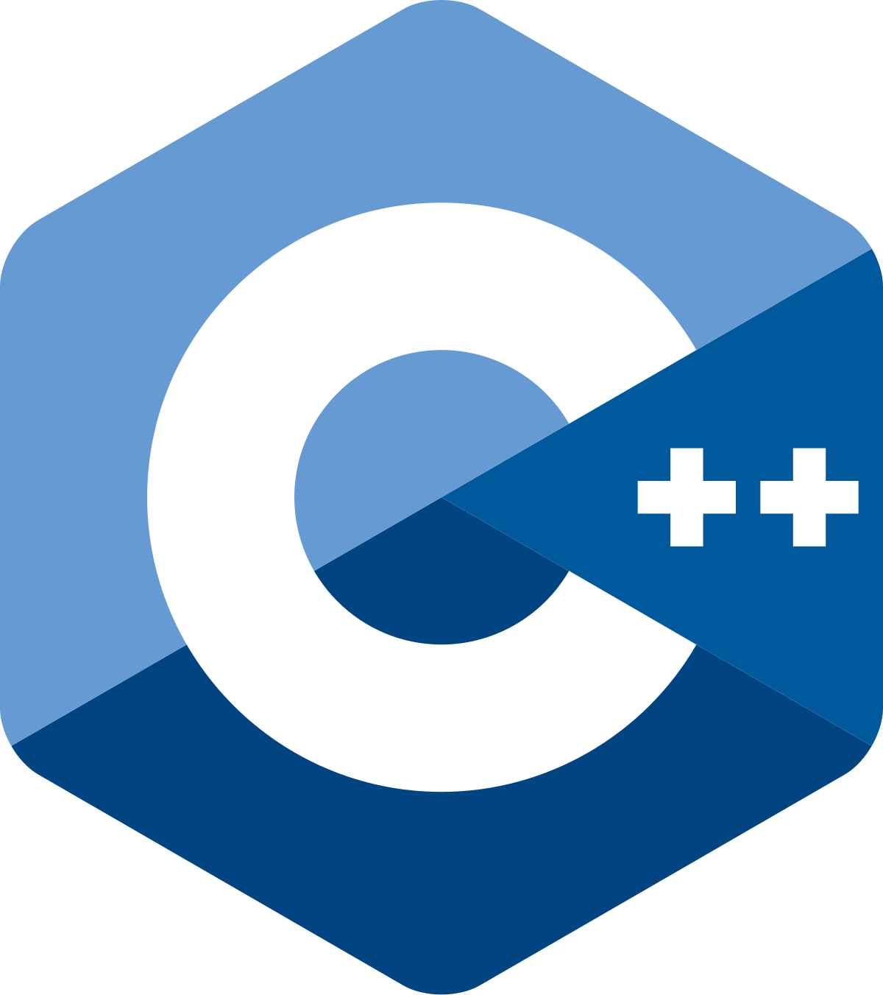
Some last ones
HTML & CSS
Very useful if you want to make good-looking dashboards or websites
C/C++
Many R functions are actually written in C or C++ (check out Rcpp package)
If you write custom functions for time-critical applications, porting some of these functions to C++ can give you the speed you look for
However, this is unlikely to concern you

Slide 55
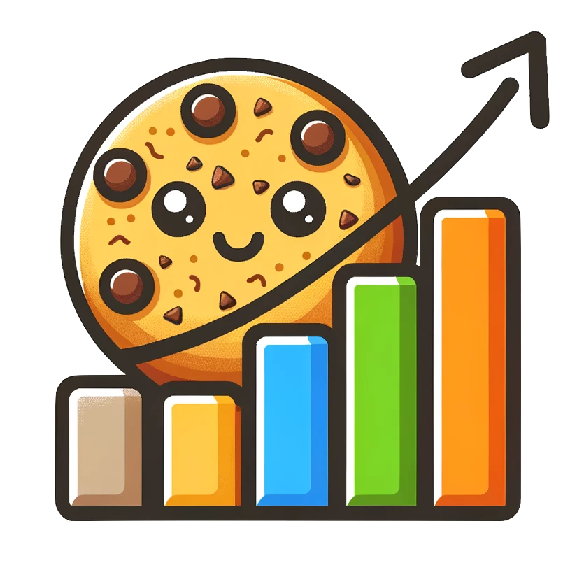
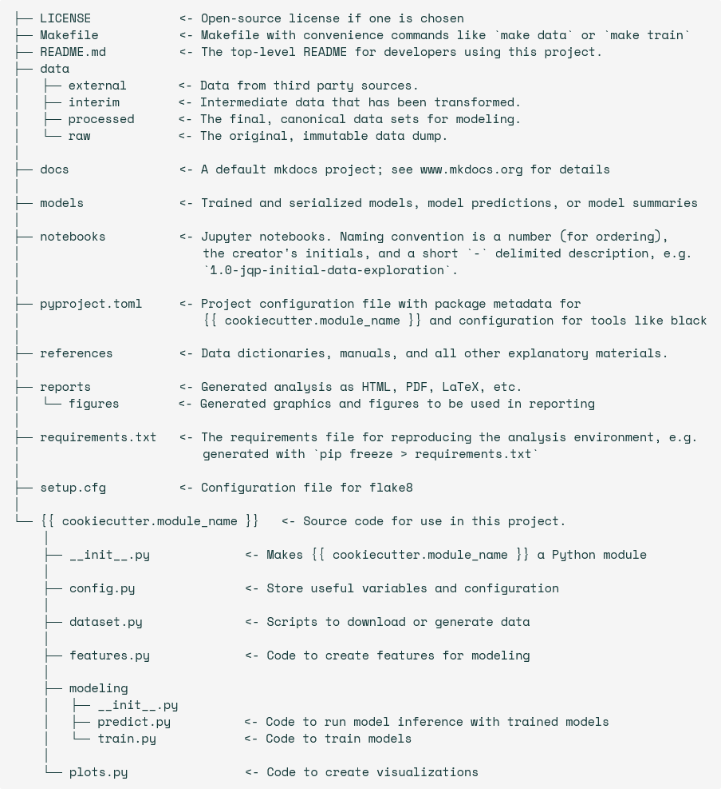
Cookiecutter Data Science
Python package that provides a basic project structure for data science work: https://cookiecutter-data-science.drivendata.org/
With other programming languages, just copy the folder structure
Useful when working with others: this is a commonly used skeleton for projects, and other data scientists won’t be lost when working on your project

Slide 56
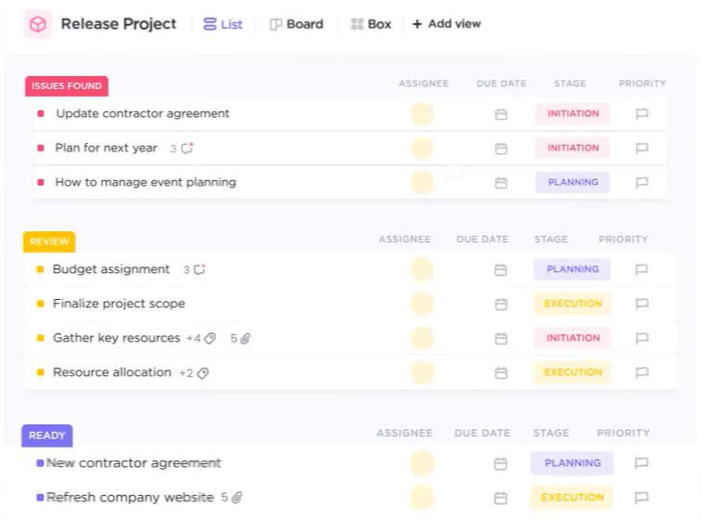
Working with others
Git (+ GitHub, GitLab…)
Version control software: keeps track of all modifications in files of a project
Great when working alone to keep a history of all changes you have made
Great when working with others, to check new modifications, review their code…
Project management tools: Trello, ClickUp…
Used to plan all steps in a project
Very useful if you work on multiple projects to keep track of all you have to do
Also great to check or report progress on tasks

Slide 57
Next week
Programming in R:
R programming refresher (hopefully)
Joins
AdventureWorks dataset
Go home.

